Slide 1
Game Programming with Elm
Splash 2016
Notes:
How many of you have programmed before? What languages? Most of these are imperative and/or object-oriented languages, while Elm is a functional programming language.
It’s like a different language family, you have to use a different way of thinking. Don’t worry if you haven’t had programming experience, you won’t have any habits to break!

Slide 2
Game programming with Elm
http://bit.ly/elmclass
http://www.elm-lang.org

Slide 3

Notes:
Turn to the person next to you and introduce yourself. This is your coding buddy. If you have a question and I'm not free, ask your coding buddy first! There's this thing called "teddy bear programming": when debugging it helps to explain your code out loud to a teddy bear. Well, you'll be each other's real life teddy bears.

Slide 4
Why Elm?

Slide 5
Why Elm?
Examples: http://elm-lang.org/Examples.elm
Clear and concise.
Almost no runtime errors.
Hot-swapping.
Time-travel debugging. (http://debug.elm-lang.org/edit/Mario.elm)
Notes:
When people write apps in Elm, often they write part of it in Elm, part of it in another language, and when the program crashes, it’s the non-Elm part.
Something about the language just makes the process of coding easier.
http://localhost:8000/elm-examples/Mario.elm?debug

Slide 6
Elm
Elm is a functional reactive programming language.
Functional:
Functions are building blocks.
Quick to program.
Type safety eliminates runtime errors.
Purity: Separates program logic from outside world.
Reactive:
Deals with signals (key presses, clicks…) coming from outside world.

Slide 7
Why functional?
Python
def quickSort(arr):
less = []
pivotList = []
more = []
if len(arr) <= 1:
return arr
else:
pivot = arr[0]
for i in arr:
if i < pivot:
less.append(i)
elif i > pivot:
more.append(i)
else:
pivotList.append(i)
less = quickSort(less)
more = quickSort(more)
return less + pivotList + more
Elm
quicksort : List comparable -> List comparable
quicksort list =
case list of
[] -> []
pivot :: rest ->
let lower = filter (\n -> n <= pivot) rest
higher = filter (\n -> n > pivot) rest
in
quicksort lower ++ [pivot] ++ quicksort higher

Slide 8
Basic programming
Notes:
A subtle difference: the program isn’t so much a list of commands as telling the computer how to obtain the result.

Slide 9
Basic programming
Primitive types: Bool, Int, Float, Char, String
http://elm-lang.org/learn/Syntax.elm
Notes:
A subtle difference: the program isn’t so much a list of commands as telling the computer how to obtain the result.

Slide 10
Basic programming: Datatypes
Primitive types: Bool, Int, Float, Char, String
Notes:
type Gender = Male | Female
type List a = Empty | (List a
type alias Person = {name : String, gender : Gender, age : Int, married : Bool}

Slide 11
What’s different about functional?
Variables are immutable.
let x = x + 1. NO.
let x’ = x + 1.
Functions always return the same value (purity).
Functions can take functions as arguments
Partial application
Notes:
A subtle difference: the program isn’t so much a list of commands as telling the computer how to obtain the result.

Slide 12
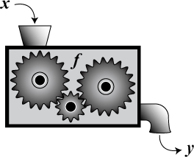
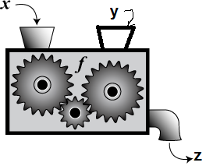
Functions are first class-citizens!
f : A -> B
f : A -> B -> C

Slide 13
Lists and Higher-order Functions
Replacements for looping
map : (a -> b) -> List a -> List b
map2 : (a -> b -> c) -> List a -> List b -> List c
foldl : (a -> b -> b) -> b -> List a -> b
Notes:
map (\x -> x+1) [1, 2, 3] gives [2, 3, 4]
M
foldl (+) 0 [1, 2, 3] gives 6
foldl (\x y -> if x then y + 1 else y) 0 [True, True, False, False, True]

Slide 14
More datatypes
Union types: types that can take one of several values
type Suit = Club | Diamond | Spade | Heart
type Gender = Male | Female
Records
type alias Card = {value : Int, suit : Suit}
type alias Student = {name : String, gender : Gender, grade : Int, scores : List Int}

Slide 15
Student example
Notes:
scores : List Int (scores is a list of integers)
average : List Int -> Int (average takes a string of integers and returns an integer)

Slide 16
Quiz
Is an element in the list?
a -> List a -> Bool
Filter a list based on a condition.
filter : (a -> Bool) -> List a -> List a
Make a list by repeating an element n times.
repeat : Int -> a -> List a
Find the first element of a list.
head : List a -> Maybe a
case (head li) of Nothing -> … Just x -> …

Slide 17
Elm architecture

Slide 18
Architecture
Model
View
Controller
Update
Signal

Slide 19

The world according to Elm (1)
Model
type alias Model =
{ location : (Float, Float), velocity : (Float, Float)}

Slide 20
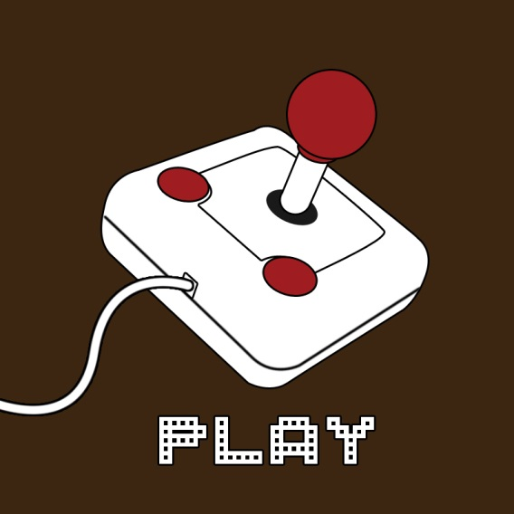
The world according to Elm (2)
Input = (Float, Float)
update :
Input -> Model -> Model
Model
Model
update

Slide 21
A signal is a value that changes over time.

Slide 22


The world according to Elm (3)
Signal Input
update
update
update
update
Signal Model
foldp update startModel input : Signal Model

Slide 23

The world according to Elm (4)
view : Model -> Element

Slide 24

The world according to Elm (4)
Signal Input
Signal Model
Update
Update
Update
Update
view
map view (foldp update startModel input) : Signal Element

Slide 25
Examples
Hello World with timer
Spaceship
Guessing game: you have 5 tries to guess a random number between 0 and 100.
Snake

Slide 26
Signal examples

Slide 27
foldp : (a -> state -> state) -> state -> Signal a -> Signal state
foldp update startModel input

Slide 28
Shapes, Forms, and Elements
Shapes and paths
circle : Float -> Shape
filled : Color -> Shape -> Form
Forms: things with coordinates
move : Float -> Float -> Form -> Form
Elements: what’s actually displayed
collage : Int -> Int -> List Form -> Element
toForm : Element -> Form
flow : Direction -> List Element -> Element
image : Int -> Int -> String -> Element

Slide 29
Go make games!
Write down the type signatures of your model and input first! Remember,
update : Input -> Model -> Model
view: Model -> Element
Make a prototype.
Break up into small parts.
Use the examples http://elm-lang.org/Examples.elm and documentation http://package.elm-lang.org/packages/elm-lang/core/2.0.0/
Notes:
In programming, there’s way too many functions to remember. Instead, have a good idea in your head of what you want to do, and then look up the functions/syntax that you need.
http://elm-lang.org/Examples.elm
If you work in groups…
Use the modular nature of functional programming to divide up work!

Slide 30
Exercises (Lists)

